Slide 1
CSE 331: Microprocessor Interfacing and Embedded Systems
Lecture 5: Instruction Representation

Slide 2
Stored-Program Concept
Computers built on 2 key principles:
Instructions are represented as numbers.
Therefore, entire programs can be stored in memory to be read or written just like numbers (data).
Simplifies SW/HW of computer systems:
Memory technology for data also used for programs

Slide 3
Consequence #1: Everything Addressed
Since all instructions and data are stored in memory as numbers, everything has a memory address: instructions, data words
both branches and jumps use these
C pointers are just memory addresses: they can point to anything in memory
Unconstrained use of addresses can lead to nasty bugs; up to you in C; limits in Java
One register keeps address of instruction being executed:
“Program Counter” (PC)
Basically a pointer to memory: Intel calls it Instruction Address Pointer, a better name

Slide 4
Consequence #2: Binary Compatibility
Programs are distributed in binary form
Programs bound to specific instruction set
Different version for Macintosh and IBM PC
New machines want to run old programs (“binaries”) as well as programs compiled to new instructions
Leads to instruction set evolving over time
Selection of Intel 8086 in 1981 for 1st IBM PC is major reason latest PCs still use 80x86 instruction set (Pentium 4); could still run program from 1981 PC today

Slide 5
Instructions as Numbers
Most of the data that we work with is in words (32-bit blocks):
Each register is a word.
LDR and STR both access memory one word at a time.
So how do we represent instructions?
Remember: Computer only understands 1s and 0s, so “ADD r0,r0,#0” is meaningless.
“Regular” ARM instructions are 32 bits.
Thumb ARM instructions are 16 bits.

Slide 6
Instructions as Numbers
Divide instruction word into “fields”
Each field tells computer something about instruction
There is an attempt to reuse fields across instructions as much as possible.
Simple = less complex hardware which generally leads to better performance

Slide 7
Data Processing Instructions
Define “fields”:
Important: Each field is viewed as an independent unsigned integer, not as part of a 32-bit integer.
Consequence: 5-bit fields can represent any number 0- 31, while 6-bit fields can represent any number 0-63.

Slide 8
ARM Registers
Register | Synonym | Role in Procedure Call Standard
r0-r1 | a1-a2 | Argument/Result/Scratch Register
r2-r3 | a3-a4 | Argument/Scratch Register
r4-r8 | v1-v5 | Variable Register
r9 | v6/sb/tr | Platform Register (static base/thread)
r10-r11 | v7-v8 | Variable Register
r12 | ip | Intra-Procedure Call Scratch Register
r13 | sp | Stack Pointer
r14 | lr | Link Register
r15 | pc | Program Counter

Slide 9
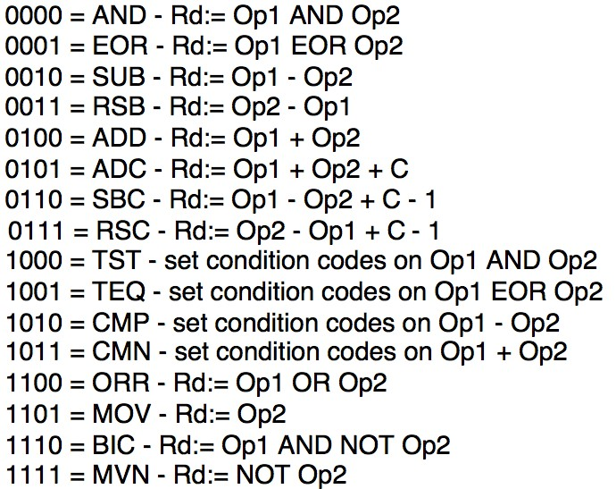
Data Processing Instructions
What do these field integer values tell us?
OpCode: specifies the specific data processing instruction

Slide 10
Data Processing Instructions
What do these field integer values tell us?
Rd: Destination Register
Rn: 1st Operand Register
Each register field is 4 bits, which means that it can specify any unsigned integer in the range 0-
15. Each of these fields specifies one of the 16 registers by number.

Slide 11
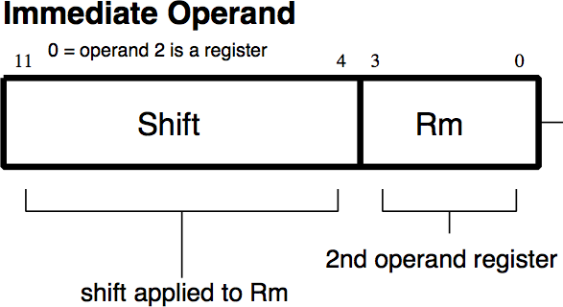
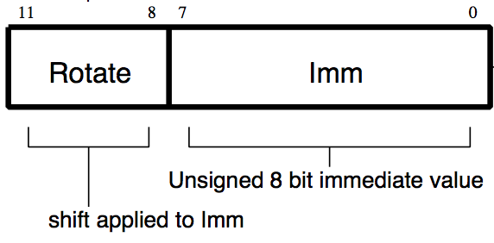
Data Processing Instructions
More fields:
I (Immediate)
0: Operand 2 is a Register
1: Operand 2 is an Immediate

Slide 12
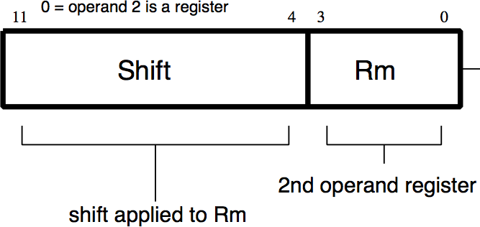
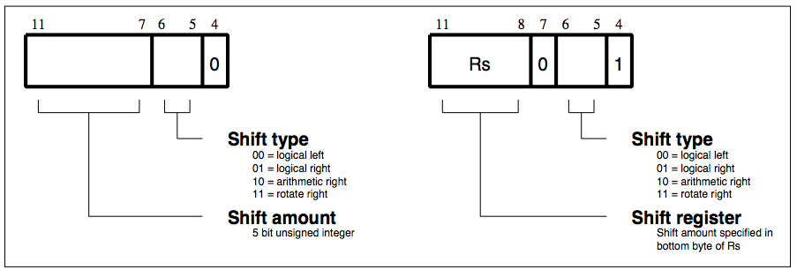
Data Processing Instructions
Operand 2:
Shift field:

Slide 13
Condition Field
jhjhjhjhjhjhjhjhjhjhjhjhjhjhjhjsasasasasasasassasasasasss

Slide 14
ARM Registers
Register | Synonym | Role in Procedure Call Standard
r0-r1 | a1-a2 | Argument/Result/Scratch Register
r2-r3 | a3-a4 | Argument/Scratch Register
r4-r8 | v1-v5 | Variable Register
r9 | v6/sb/tr | Platform Register (static base/thread)
r10-r11 | v7-v8 | Variable Register
r12 | ip | Intra-Procedure Call Scratch Register
r13 | sp | Stack Pointer
r14 | lr | Link Register
r15 | pc | Program Counter

Slide 15
Data Processing Instructions
More fields:
S (Set Condition Fields)
0: Do not alter condition fields
1: Set condition fields
These set the C, N, Z, V flags in the CPSR
Cond (Condition Field)
Determines whether the instruction resulted is committed
Used with ADDEQ, ADDNE, ADDGT, etc.

Slide 16
Data Processing Instructions
Define “fields”:
Important: Each field is viewed as an independent unsigned integer, not as part of a 32-bit integer.
Consequence: 5-bit fields can represent any number 0- 31, while 6-bit fields can represent any number 0-63.

Slide 17
Loading Constants
Constants can only be 8 bit numbers
Allows assignment of numbers between 0-255 or [0x00 – 0xFF]
Why? Constants stored in code and there is limited space (only 32 bits).
Assignment in Assembly
Example: | MOV | r0,#0xFF (in ARM)
Equivalent to: | a = | 255 (in C)
where ARM registers r0 C variable a

Slide 18
Using a Barrel Shifter
Register, optionally with shift operation
Shift value can be either be:
5 bit unsigned integer
Specified in bottom byte of
another register.
Used for multiplication by constant
Immediate value
8 bit number, with a range of
0-255.
Rotated right through even
number of positions
Allows increased range of 32- bit constants to be loaded directly into registers
Operand 1 Operand 2
Barrel Shifter
ALU
Result

Slide 19
Immediate Constants
The data processing instruction format has 12 bits available for operand2
0xFF000000
MOV r0, #0xFF, ROR #8
x2
Shifter
ROR
4 bit rotate value (0-15) is multiplied by two to give range 0-30 in steps of 2
Rule to remember is “8-bits rotated right by an even number of bit positions”

Slide 20
Shifts and Rotates
LSL – logical shift left by n bits – multiplication by 2^{n}
C
 |  |  | …
0
LSR–logical shift right by n bits–unsigned division by 2^{n}
0
 |  |  | …
C
ASR – arithmetic shift right by n bits – signed division by 2^{n}
 |  |  | …
C
ROR – rotate right by n bits – 32 bit rotate
…

Slide 21
Loading Constants
Rotate Value | Binary | Decimal | Hexadecimal
0 | 000000000000000000000000xxxxxxxx | 0-255 | 0-0xFF
Right, 30 bits | 0000000000000000000000xxxxxxxx00 | 4-1020 | 0x4-0x3FC
Right, 28 bits | 00000000000000000000xxxxxxxx0000 | 16-4080 | 0x10-0xFF0
Right, 26 bits | 000000000000000000xxxxxxxx000000 | 128-16320 | 0x40-0x3FC0
… | … | … | …
Right, 8 bits | xxxxxxxx000000000000000000000000 | 16777216- 255x2²⁴ | 0x1000000- 0xFF000000
Right, 6 bits | xxxxxx0000000000000000000000xx | - | -
Right, 4 bits | xxxx0000000000000000000000xxxx | - | -
Right, 2 bits | xx0000000000000000000000xxxxxx | - | -
This scheme can generate a lot, but not all, constants.
~50% of constants between [-15,150, 15,150];
~90% between [-512,512]
❖ Others must be done using literal pools (more on that later)

Slide 22
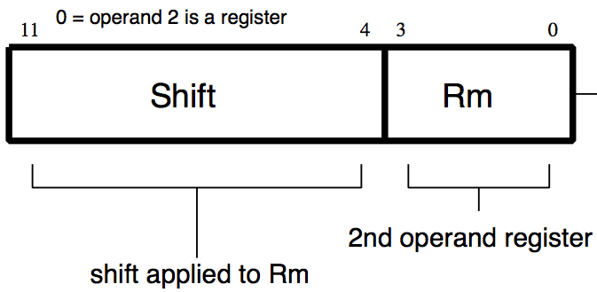
Data Processing Example
ARM Instruction: ADD r0,r1,r2
cond = 1110 (always – unconditional)
S = 0 (not ADDS)
I = 0 (second operand not a constant)
opcode = 0100 (look up)
rd = 0 (destination operand)
rn = 1 (first operand) operand 2
shift = 0
Rm = 2

Slide 23
Data Processing Example
ARM Instruction: ADD r1,r0,r1
1110
⁰ ⁰¹⁰⁰ 0
0000
0001
00000000 0001
Binary number per field representation: hex representation: 0xE0810002
Called a Machine Language Instruction

Slide 24

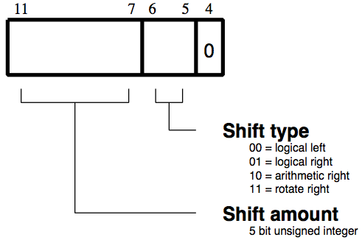
Data Processing Example
ARM Instruction:
SUBEQ a1,v7,r2,LSL #3
cond = 0000 (equal)
S = 0 (not SUBEQS)
I = 0 (second operand not a constant)
opcode = 0010 (look up)
rd = 0000 (destination operand: a1 = r0) rn = 1010 (1st operand: v7 = r10) operand 2
rm = 0010 (2nd operand: r2)
shift amount = 00011
Shift Type = 00

Slide 25
Data Processing Example
ARM Instruction: SUBEQ a1,v7,r2,LSL #3
#3
0000
0 ⁰⁰¹⁰
0
1010
0000
00011 00 0 0010
Hex representation:
0x004A0182

Slide 26
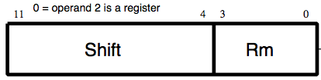
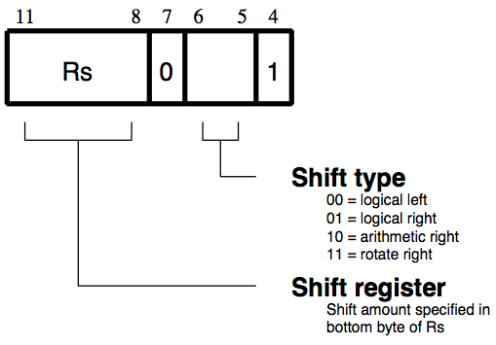
Data Processing Example
ARM Instruction:
BIC v6,a1,a2,ROR v2
cond = 1110 (always)
S = 0 (not BICS)
I = 0 (second operand not a constant)
opcode = 1110 (look up)
rd = 1001 (destination operand: v6 = r9) rn = 0000 (1st operand: a1 = r0) operand 2
rm = 0001 (2nd operand: a2 = r1)
rs = 0101 (shift operand: v2 =r5)
Shift Type = 11 (ROR)

Slide 27
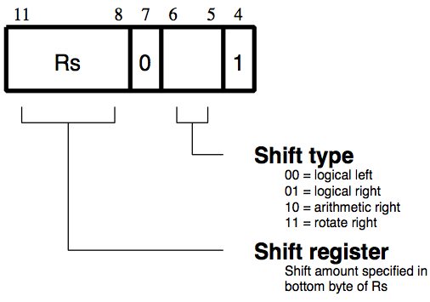
Data Processing Example
ARM Instruction: BIC v6,a1,a2,ROR v2
❖#3
1110
0 ¹¹¹⁰
0
0000
1001
0101 0 11 1 0001
Hex representation:
0xE1C09571

Slide 28
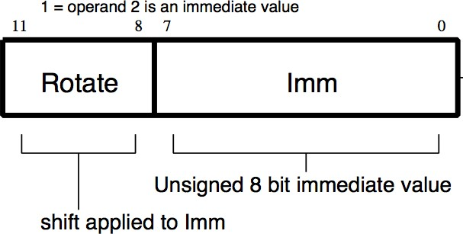
Data Processing Example
ARM Instruction:
EORGTS r6,r2,#10
cond = 1100 (greater than)
S = 1
I = 1 (second operand is a constant)
opcode = 0001 (look up)
rd = 0110 (destination operand: r6)
rn = 0010 (1st operand: r2)
operand 2
rotate = 0000
imm = 0x0A

Slide 29
Data Processing Example
ARM Instruction: EORGTS r6,r2,#10
❖#3
1100
1 ⁰⁰⁰¹
1
0010
0110
0000 0000 1010
Hex representation:
0xC232600A

Slide 30
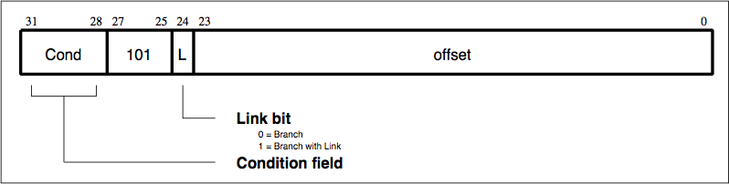
Branch Instructions
What fields do we need for Branch Instructions?
Opcode
Label
Condition

Slide 31
Branch Instructions
Opcode
101 for Branch
Link bit is set if BL
Condition – same as before (EQ, LT, GT,
etc.)

Slide 32
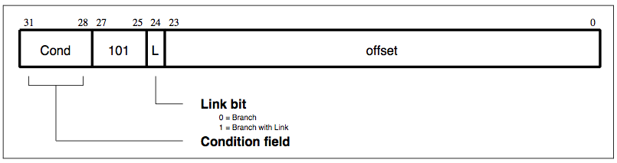
Branch Instructions
Label
Uses offset, i.e., how far to branch. PC = nextPC + offset.
As opposed to absolute address of the instruction.
24 bits allows us to branch +/- 8 Mbytes.
Instructions 32 bits = 4 bytes, so add implicit 00 at end. Now can branch +/- 32 Mbytes.
Equivalent to +/- 8 Minstructions.
❖Start counting 2 instructions later (due to pipelining).

Slide 33
Branches: PC-Relative Addressing
Solution to branches in a 32-bit instruction: PC-Relative Addressing
Let the 24-bit offset field be a signed two’s complement integer to be added to the PC if we take the branch.
Now we can branch +/- 2²³ bytes from the PC, which should be enough to cover almost any loop.
Any ideas to further optimize this?
sdsdssssssssssssssssssssssssssssssssssssss

Slide 34
Branches: PC-Relative Addressing
Note: Instructions are words, so they’re word aligned (byte address is always a multiple of 4, which means it ends with 00 in binary).
So the number of bytes to add to the PC will always be a multiple of 4.
So specify the offset in words.
Now, we can branch +/- 2²³ words from the PC (or +/- 2²⁵ bytes), so we can handle loops 4 times as large.

Slide 35
Branches: PC-Relative Addressing
Branch Calculation:
If we don’t take the branch:
PC = PC+4 +Offset* 4
If we do take the branch:
PC = (PC + 8) + (offset * 4)
Why two? Pipelining starts next two following instructions before current one is finished.
Further explanation: https://docs.google.com/document/d/14h_NjrbxrZioHhU6ruQBmt_Xtl7a_xlm0WrbMigEQeA/edit?usp=sharing

Slide 36
Branches: PC-Relative Addressing
Branch Calculation:
Observations
offset field specifies the number of words to jump, which is simply the number of instructions to jump.
offset field can be positive or negative.
Due to hardware, add immediate to (PC+8), not to PC

Slide 37
Branch Example
ARM Instruction: here BEQ here
cond = 0000 (equal)
L = 0 (not a BL instruction)
Offset = -2 = 0xFFFFFE Number of instructions to add to (or subtract from) the PC, starting at two instructions following the branch (PC is two instructions ahead due to pipelining)
0000
0
1111 1111 1111 1111 1111 1110
Hex representation: 0x0AFFFFFE

Slide 38
Branch Example
ARM Instruction:
there
ADD r0, r1, r2
SUBEQ a1, v7, r2, LSL #3 BIC v6, a1, a2, ROR v2
EORGTS r6,r2,#1
BL there
here
1110
1
1111 1111 1111 1111 1111 1010
cond = 1110 (always)
L = 1 (BL instruction)
Offset = -6 110 = 0xFFFFFA
Hex representation: 0xEBFFFFFA

Slide 39
Large Offsets
Chances are that offset is small enough to fit in the immediate field.
How do we usually use branches?
Answer: if-else, while, for
Loops are generally small: typically up to 50 instructions
Conclusion: may want to branch to anywhere in memory, but a branch often changes PC by a small amount
What if too big?
❖Load branch target into a register (IP) and BX

Slide 40
Questions on PC-addressing
Does the value in branch field change if we move the code?
What do we do if destination is > 2^23 instructions away from branch?
Since its limited to +- 2^23 instructions, doesn’t this generate lots of extra ARM instructions?

Slide 41

Data Transfer Instructions
Cond: condition field. Execute instruction when condition is met.
I: immediate field. Determines type of offset.
0: if offset is an immediate
1: if offset is a register
P: pre/post indexing bit.
0: post - add offset after transfer
1: pre - add offset before transfer

Slide 42
Data Transfer Instructions
U: up/down bit.
0: down - subtract offset from base
1: up - add offset to base
B: byte/word bit.
0: transfer word quantity
1: transfer byte quantity
W: write-back bit.
0: no write-back
1: write address into base

Slide 43
Data Transfer Instructions
L: load/store bit.
0: store into memory
1: load from memory
Rn: base register
Rd: source/destination register

Slide 44
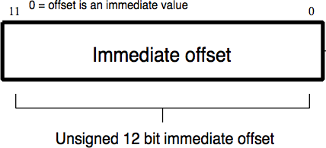
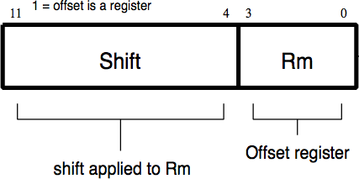
Data Transfer Instructions
Offset: source/destination register
I bit = 0
I bit = 1

Slide 45
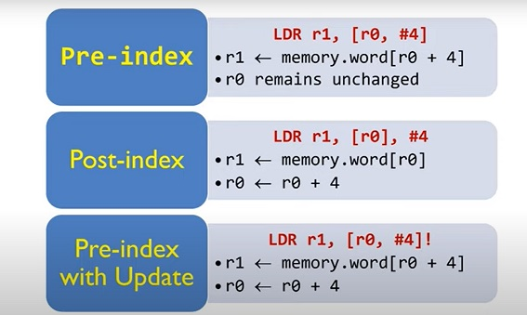
Addressing Mode
https://www.youtube.com/watch?v=zgkxPdPkxa8&ab_channel=EmbeddedSystemsandDeepLearning

Slide 46
Data Transfer Example
ARM Instruction: LDR r8,[sp]
cond = 1110 (always – unconditional)
I = 0 (immediate: there is no offset, or offset = 0)
P = 1 (pre-increment: there is no offset)
U = 1 (add offset to base; there is no offset)
B = 0 (transfer word)
W = 0 (no writeback)
L = 1 (load)
rd = 8 = 1000 (destination operand)
rn = 13 = 1101 (base register)
Offset = 0 (there is no offset)

Slide 47
Data Transfer Example
ARM Instruction: LDR r8,[sp]
1110
⁰ ¹ ¹ ⁰ ⁰ ¹ 1101
1000
0000 0000 0000
Binary number per field representation: hex representation: 0xE59D8000

Slide 48
Data Transfer Example
ARM Instruction: STRB r10,[sp,#-4]!
cond = 1110 (always – unconditional)
I = 0 (offset is an immediate value)
P = 1 (pre-index – add immediate before transfer)
U = 0 (subtract offset from base)
B = 1 (transfer byte)
W = 1 (write address into base)
L = 0 (store)
rd = 10 = 1010 (destination operand)
rn = sp = r13 = 1101 (base register)
Offset = 0x004

Slide 49
Data Transfer Example
ARM Instruction: STRB r10,[sp,#-4]!
1110
⁰ ¹ ⁰ ¹ ¹ ⁰ 1101
1010
0000 0000 0100
Binary number per field representation: hex representation: 0xE56DA004

Slide 50
Data Transfer Example
ARM Instruction: LDRB r2,[r1],-r3, LSR #4
cond = 1110 (always – unconditional)
I = 1 (offset is a register)
P = 0 (post-index – add immediate after transfer)
U = 0 (subtract offset from base)
B = 1 (transfer byte)
W = 1 (write address into base)
L = 1 (load)
rd = 2 = 0010 (destination operand)
rn = 1 = 0001 (base register)

Slide 51
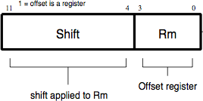
Data Transfer Example
ARM Instruction: LDRB r2,[r1],-r3, LSR #4
Offset: shift:
shift amount = 4 = 00100
shift type = 01 rm = 3 = 0011

Slide 52
Data Transfer Example
ARM Instruction: LDRB r2,[r1],-r3, LSR #4
1110
¹ ⁰ ⁰ ¹ ⁰ ¹ 0001
0010
00100 01 0 0011
Binary number per field representation: hex representation: 0xE651223

Slide 53
ARM Instruction: LDRB r2,[r1],-r3, LSR #4

Slide 54
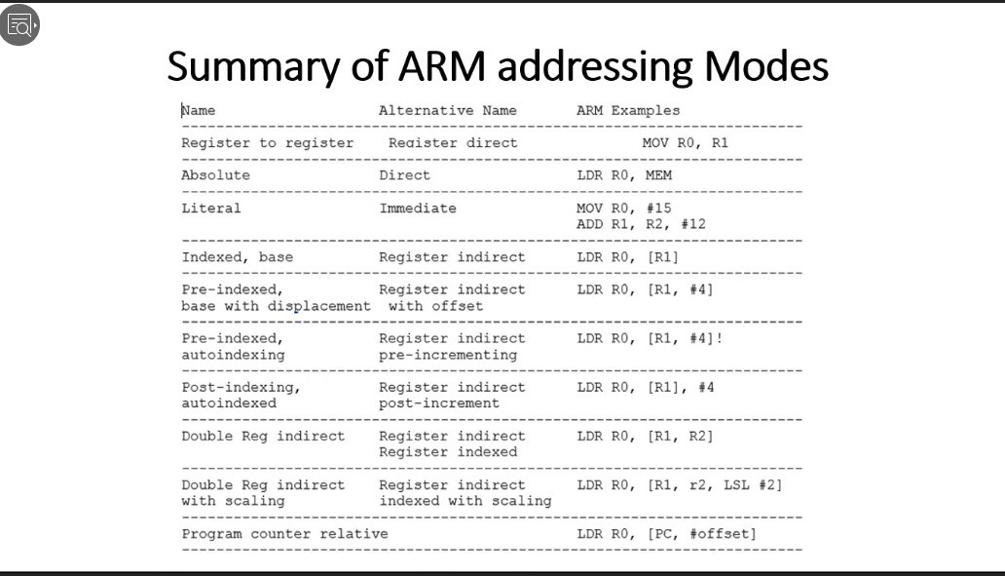
Addressing Mode

Slide 55
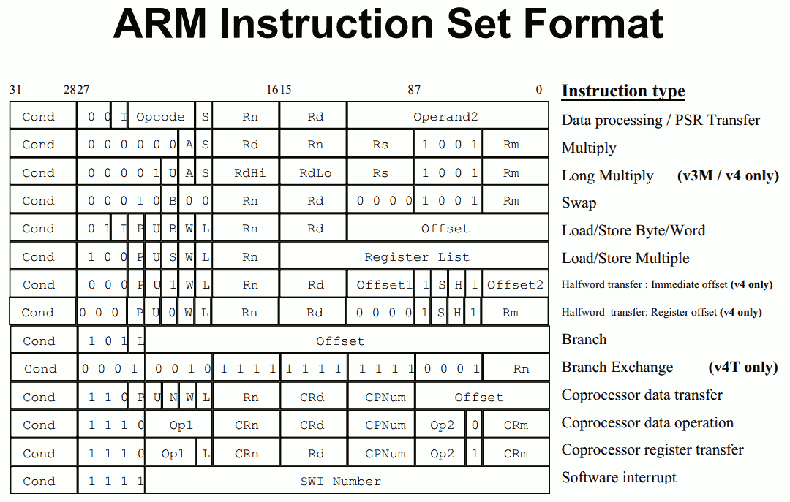
Instruction Format Summary

Slide 56
Conclusion
Computer actually stores programs as a series of these 32-bit numbers.
Each instruction has different number of fields that define it (opcode, registers, immediates, etc.)
ARM Machine Language Instruction: 32 bits representing a single instruction

